Slide 1
Security and Operational Visibility
ACE-Security
Notes:
ACE-Security course is built by Shahzad Ali with the help from Joe and Rizwan from ACE Team.
For comments, please reach out to shahzad@aviatrix.com for comments or improvements.

Slide 2
Security and Operational Visibility
Tenet from NIST Publication 800-207 - Zero Trust Architecture (ZTA)
The enterprise collects as much information as possible about the current state of assets, network infrastructure, and communications and uses it to improve its security posture.
An enterprise should collect data about asset security posture, network traffic, and access requests, process that data, and use any insight gained to improve policy creation and enforcement.
You cannot protect what you cannot see
Consistent design with consistent operational visibility
End-to-End observability
Noise-free and single plane of glass

Slide 3
CoPilot Demo

Slide 4
Focus Areas
Geoblocking
ThreatIQ Logs
Network Segmentation
Microsegmentation in AWS/Azure
Egress Visibility
SmartGroup visibility aspects
CIDR Approval

Slide 5
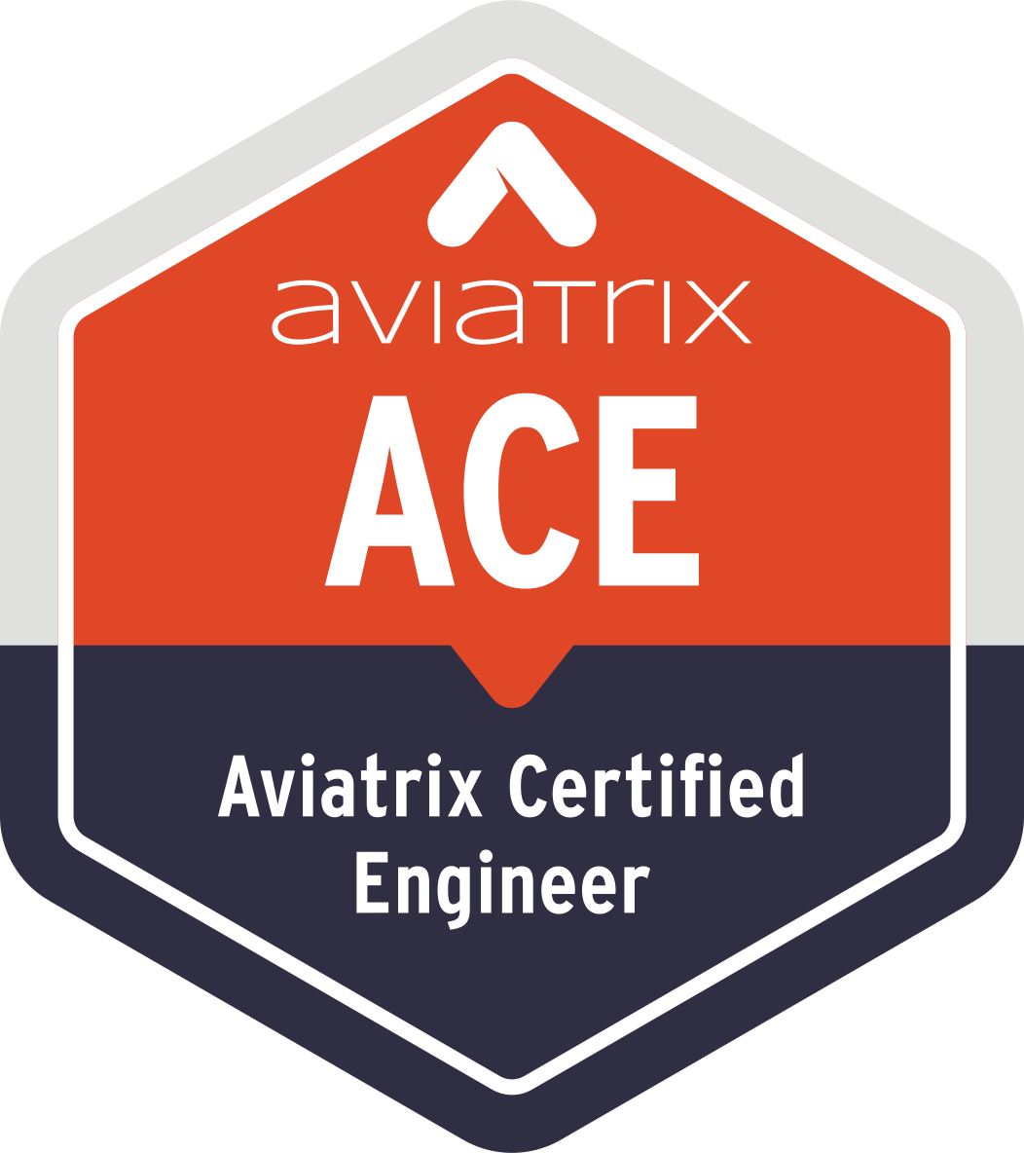

Aviatrix Certified Engineer (ACE)
COMMUNITY
https://aviatrix.com/ACE
https://community.aviatrix.com

